Slide 1
DS22 noise studies
Nikolai Beev
TE-EPC-HPM
26.04.2018

Slide 2
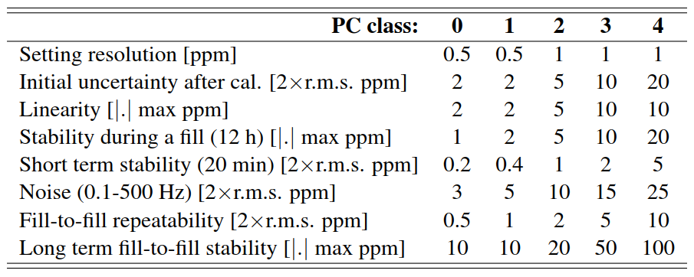
HL-LHC Requirements
Document: CERN-ACC-2017-0101
http://cds.cern.ch/record/2298764/files/CERN-ACC-2017-0101.pdf
Page 15, table 6
LF noise, machine temperature cycle
LF noise, toughest specification
Broadband noise.
Mostly for monitoring, but its LF part
may be significant for regulation up
to a few Hz.
50:50 split with safety margin:
0.2 ppm (2xRMS) -> 0.1 ppm_{RMS}
ADC
LF noise, temperature cycle
DCCT
0.05 ppm_{RMS}
500 nV_{RMS}
RTI, FS = 10 V
0.05 ppm_{RMS}
500 nV_{RMS}
RTO, FS = 10 V

Slide 3
Noise Measurements
Working in the frequency domain has numerous advantages:
the type of noise is immediately visible (white, 1/f, narrowband peaks, etc.)
Bandwidths of interest can be defined sharply (e.g. 0.001-0.1 Hz)
HL-LHC fill stability and short-term stability requirements are defined through frequency bands

Slide 4
A bit on FFT and PSD estimation
In order to resolve LF components in the frequency domain, the time-domain record has to be sufficiently long
For the DS22, we use records of 1600 s (≈26 min). The first resolved FFT bin is 1.25 mHz
A single FFT estimate (periodogram) has high variance. We decrease it by averaging multiple windowed periodograms (Bartlett method)
Typically, we average >30 FFTs from an overnight measurement cycle (>12 h)

Slide 5
An example
random white noise
x window (Hanning)
Modified periodogram
FFT,
Averaging of FFTs
Bartlett, 10x averages
FFT length is set
by the window length
Welch, 20x averages

Slide 6
Unmodified DS22 Noise
UNNOWN
until 2018
Poorly known
until 2018
well understood
EDMS 1792151 v.1
modulator
quantization noise…
well understood,
largely unimportant
well understood
chopper
stage /
crossover
white
noise
1/f region
EDMS 1953928 v.1

Slide 7
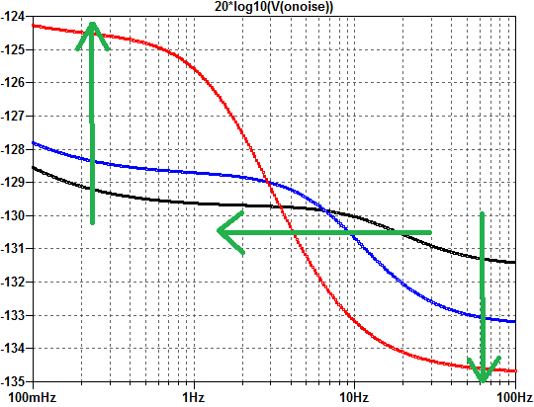
DS22 improvements
605 nV_{RMS}
220 nV_{RMS}
≈120 nV_{RMS}
₋₋₋₋₋₋₋₋₋₋₋₋₋₋₋₋₋₋₋₋₋₋₋₋₋₋
in total: 5x improvement
2.3 effective bits
HL-LHC Class 0
short-term stability requirement BW
Noise behaviour for f >0.01 Hz
very well understood
(LF, crossover, HF)

Slide 8
Dominant noise source
By replacing op amps one by one, it was determined that IC10 contributes almost all of the 1/f noise. The origin is most likely its 1/f current noise.

Slide 9
Other Culprits
When the DS22 box is open, higher LF noise is observed due to free air flow (TC / thermal EMFs?)

Slide 10
Reference noise
With shorted inputs, the noise originating from V_{ref} is suppressed due to the symmetry of the +5V and -5V ref. lines
V_{ref} noise is also suppressed when the DS22 measures its own V_{ref}
+10V or -10V from a PBC show the same LF noise level

Slide 11
LTZ1000 LF noise
200 nV_{RMS}
120 nV_{RMS}
≈160 nV_{RMS} uncertain
PBC or DS22 reference?
Device-to-device variation?
BAD NEWS:
We can’t measure reliably
below this line.
PBC noise is on the same order
≈140-160 nV_{RMS} (0.001-0.1 Hz)
GOOD NEWS:
Even considering the
worst-case scenario,
at +10 V input we are still
safely within the HL-LHC specs

Slide 12
More on LTZ1000 LF noise
We would like to better understand the LF noise of LTZ1000
For all of the new ADCs, we should characterize and keep track of the LTZs
Study LF noise before and after burn-in?
Ultimate metrological characterization: ADC against JJ calibrator. Collaboration with METAS/PTB/etc. foreseen.

Slide 13
Things to improve
Input buffer, V_{ref} buffers (OPA227, OPA277) - to be replaced with ADA4522-1
All thick-film resistors in the signal / V_{ref} path to be replaced with thin-film
All non-NP0 ceramic capacitors in the signal / V_{ref} path to be replaced with plastic (ECPU)
Small improvement (≈2 dB) in broadband noise is possible with some filtering of the -5V ref.
Temperature stabilization loop can be improved (work in progress)

Slide 14
Conclusions
DS22 can be improved considerably in terms of LF noise
The HF noise of DS22 is presently dominated by the digital filter / decimation in the FPGA. There is no strong pressure to improve it in the DS22 hardware. By itself it meets the specs.
Ultimately, at very LF (< 0.01 Hz) any ADC will be limited by the reference noise (LTZ1000)
We are at the limit of our measurement capability when it comes to LTZ1000 LF noise

